Slide 1
Voice Assistant
Tejas Sakunde(331)

Slide 2
Introduction
An intelligent virtual assistant (IVA) or intelligent personal assistant (IPA) is a software agent that can perform tasks or services for an individual based on commands or questions. Sometimes the term "chatbot" is used to refer to virtual assistants generally or specifically accessed by online chat. In some cases, online chat programs are exclusively for entertainment purposes. Some virtual assistants are able to interpret human speech and respond via synthesized voices.
Voice assistants come in somewhat small packages and can perform a variety of actions after hearing a wake word or command. They can turn on lights, answer questions, play music, place online orders, etc.

Slide 3
Purpose and Applicability
Purpose
With the addition of separate apps on the phone, our voice can be a type of remote control for our lives. We can unlock cars and homes, turn on lights, adjust the thermostat, change the television channel, and much more.
Applicability
Virtual assistants may be integrated into many types of platforms or, like Amazon Alexa, across several of them:
Into devices like smart speakers such as Amazon Echo, Google Home and Apple HomePod
In instant messaging apps on both smartphones and via the Web, e.g. Facebook's M (virtual assistant) on both Facebook and Facebook Messenger apps or via the Web

Slide 4
SURVEY OF TECHNOLOGY
Python
MYSQL
StarUML
Pip
Speech recognition engine
Pyttsx3
Pygame

Slide 5
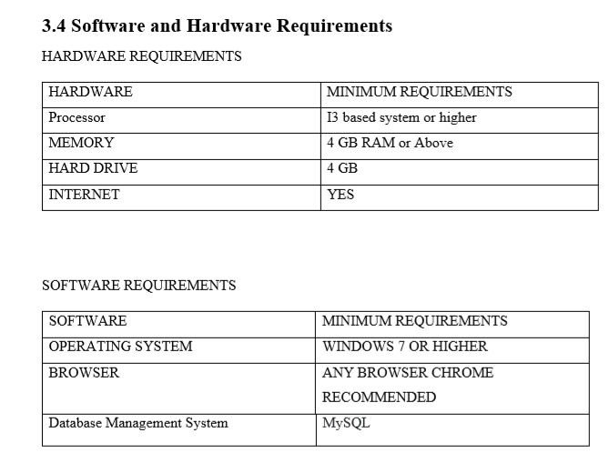
REQUIREMENTS AND ANALYSIS

Slide 6
CONCEPTUAL MODELS
WATERFALL MODEL
Waterfall approach was first SDLC Model to be used widely in Software Engineering to ensure success of the project. In "The Waterfall" approach, the whole process of software development is divided into separate phases. In this Waterfall model, typically, the outcome of one phase acts as the input for the next phase sequentially

Slide 7
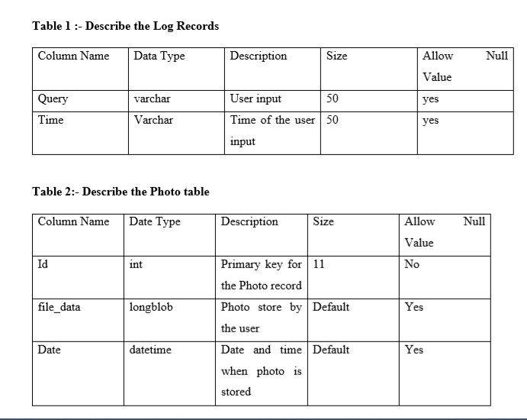
SYSTEM DESIGN

Slide 8
Implementation and Testing
Vs Code (Software Used)
Visual Studio Code is a lightweight but powerful source code editor which runs on your desktop and is available for Windows, macOS and Linux. It comes with built-in support for JavaScript, TypeScript and Node.js and has a rich ecosystem of extensions for other languages (such as C++, C#, Java, Python, PHP, Go) and runtimes (such as .NET and Unity).

Slide 9
Coding used in project
Audio (to send output in audio format)
import speech_recognition as sr
import pyttsx3, datetime, sys, wikipedia, wolframalpha, os, smtplib, random, webbrowser, pygame, subprocess
def speak(audio):
print('Karen:', audio)
engine.setProperty('voice', voices[len(voices) - 1].id)
engine.say(audio)
engine.runAndWait()

Slide 10
Functionality of Code
The user use start button to give input for performing operations.
The operation perform are :-
Open Google
Open YouTube
Open Google Chrome
Play Music
Search Google

Slide 11
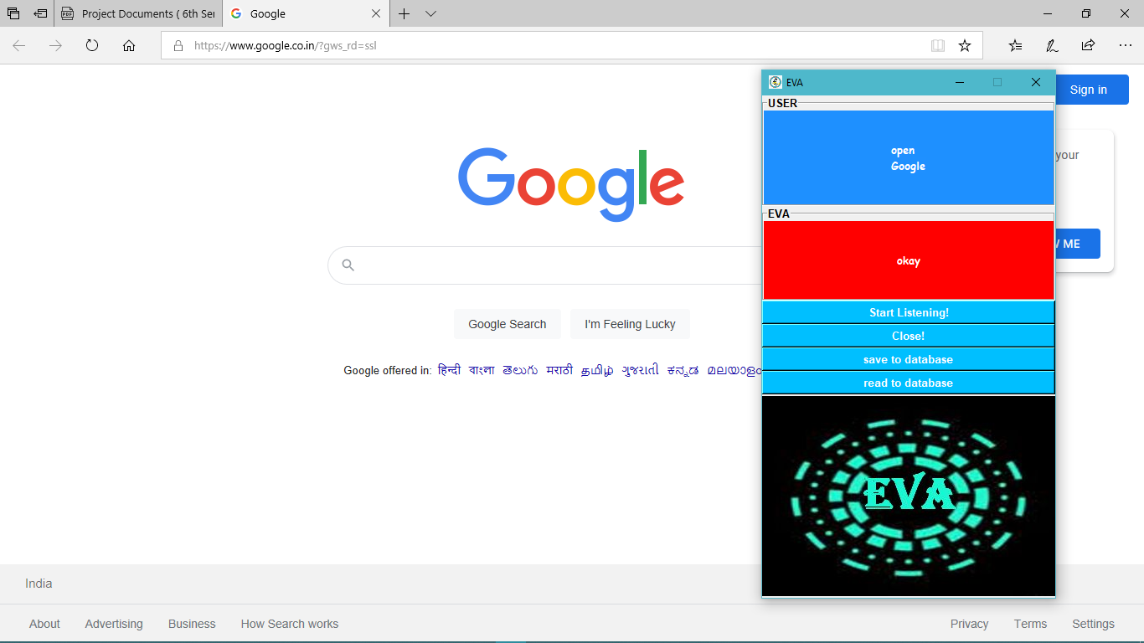
Results
Opening Google in Web Browser

Slide 12
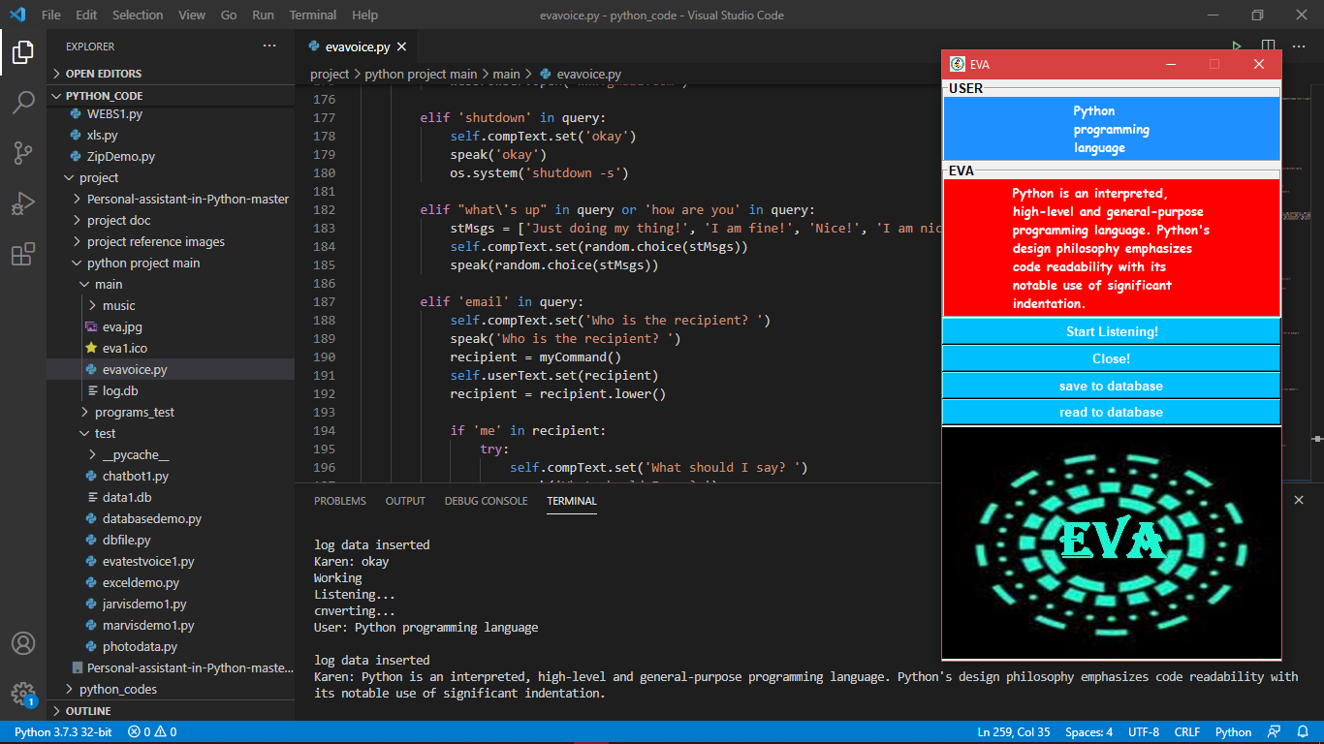
Searching on Web for given Query

Slide 13
USER DOCUMENTATION
User Documentation part consist of the description about all the forms that the application contains, they are as follows: -
Use start button to give command.
If you don’t give command in 5 seconds it will stop listening to the command and will say try again.
You can use “stop’,”abort”,”quit” to stop the application and you can also use close button given below start button.
Your log data is saved in log.db file

Slide 14
FUTURE WORK
Machine learning and artificial intelligence are making huge impacts on almost every industry. The e-commerce trend, in particular, has been dramatically transformed by AI-powered voice assistants. Voice interfacing is also advancing at a fast rate in the banking and healthcare industries to keep up with the demands of modern consumers.
Millennial consumers are fueling the shift towards voice assistants powered by artificial intelligence. Significant AI adoption is driving the move to voice applications. Additionally, IoT devices such as thermostats, speakers, and smart appliances are making voice assistants ever more useful in the lives of everyday users.

Slide 15
REFERENCES
1) For Python installation:
https://www.python.org/
2) For Visual studio code installation:
https://code.visualstudio.com/download
3) For Python pip installation:
https://pypi.org/project/pip/
4) For Mysql Installation
https://dev.mysql.com/downloads/
5) https://www.google.com/
6) https://www.youtube.com/

Slide 16
THANK YOU

